Slide 1

Natural Language Processing
Rohit Kate
Information Extraction – Part 2

Slide 2
Evaluating IE
Measure for each entity type and for each relation type:
Total number of correct extractions: N
Total number of extractions by the system: E
Number of extractions that are correct: C
Compute average value of metrics adapted from IR:
Recall = C/N
Precision = C/E
These could be computed for each type of entity and reported, or averaged over all entity types and reported

Slide 3
Evaluation: NER (protein names)
Extracted:
TI - Two potentially oncogenic cyclins, cyclin A and cyclin D1, share common properties of subunit configuration, tyrosine phosphorylation and physical association with the Rb protein
AB - Originally identified as a ‘mitotic cyclin’, cyclin A exhibits properties of growth factor sensitivity, susceptibility to viral subversion and association with a tumor-suppressor protein, properties which are indicative of an S-phase-promoting factor (SPF) as well as a candidate proto-oncogene …
Moreover, cyclin D1 was found to be phosphorylated on tyrosine residues in vivo and, like cyclin A, was readily phosphorylated by pp60c-src in vitro.
In synchronized human osteosarcoma cells, cyclin D1 is induced in early G1 and becomes associated with p9Ckshs1, a Cdk-binding subunit.
Immunoprecipitation experiments with human osteosarcoma cells and Ewing’s sarcoma cells demonstrated that cyclin D1 is associated with both p34cdc2 and p33cdk2, and that cyclin D1 immune complexes exhibit appreciable histone H1 kinase activity …
N=14
E=11 C = 9
Precision = 9/11=81.81% Recall = 9/14 = 64.29%

Slide 4
Evaluation IE
There is a trade-off between precision and recall
Extract everything: 100% recall, very low precision
Extract very few examples that you are most confident on: Very high precision, very low recall
Hence precision and recall should always be reported together

Slide 5
Evaluation IE
Method A gives 90% precision and 70% recall. Method B gives 85% precision and 80% recall. Which method is better?
Difficult to compare because one has a better precision and other has a better recall
Sometimes the harmonic mean of precision and recall, called F-measure, is reported which in a single measure summarizes both:
F-measure = 2*Precision*Recall/(Precision + Recall)
Both precision and recall should be good in order to get a good F-measure
For Method A, F-measure = (2*90*70)/(90+70) = 78.75%
For Method B, F-measure = (2*85*80)/(85+80) = 82.42%
Method B will be considered better (unless the application particularly requires high precision in which case Method A will be considered better)

Slide 6
Evaluation: NER (protein names)
Extracted:
TI - Two potentially oncogenic cyclins, cyclin A and cyclin D1, share common properties of subunit configuration, tyrosine phosphorylation and physical association with the Rb protein
AB - Originally identified as a ‘mitotic cyclin’, cyclin A exhibits properties of growth factor sensitivity, susceptibility to viral subversion and association with a tumor-suppressor protein, properties which are indicative of an S-phase-promoting factor (SPF) as well as a candidate proto-oncogene …
Moreover, cyclin D1 was found to be phosphorylated on tyrosine residues in vivo and, like cyclin A, was readily phosphorylated by pp60c-src in vitro.
In synchronized human osteosarcoma cells, cyclin D1 is induced in early G1 and becomes associated with p9Ckshs1, a Cdk-binding subunit.
Immunoprecipitation experiments with human osteosarcoma cells and Ewing’s sarcoma cells demonstrated that cyclin D1 is associated with both p34cdc2 and p33cdk2, and that cyclin D1 immune complexes exhibit appreciable histone H1 kinase activity …
N=14
E=11 C = 9
Precision = 9/11=81.81% Recall = 9/14 = 64.29%
F-measure = 72%

Slide 7
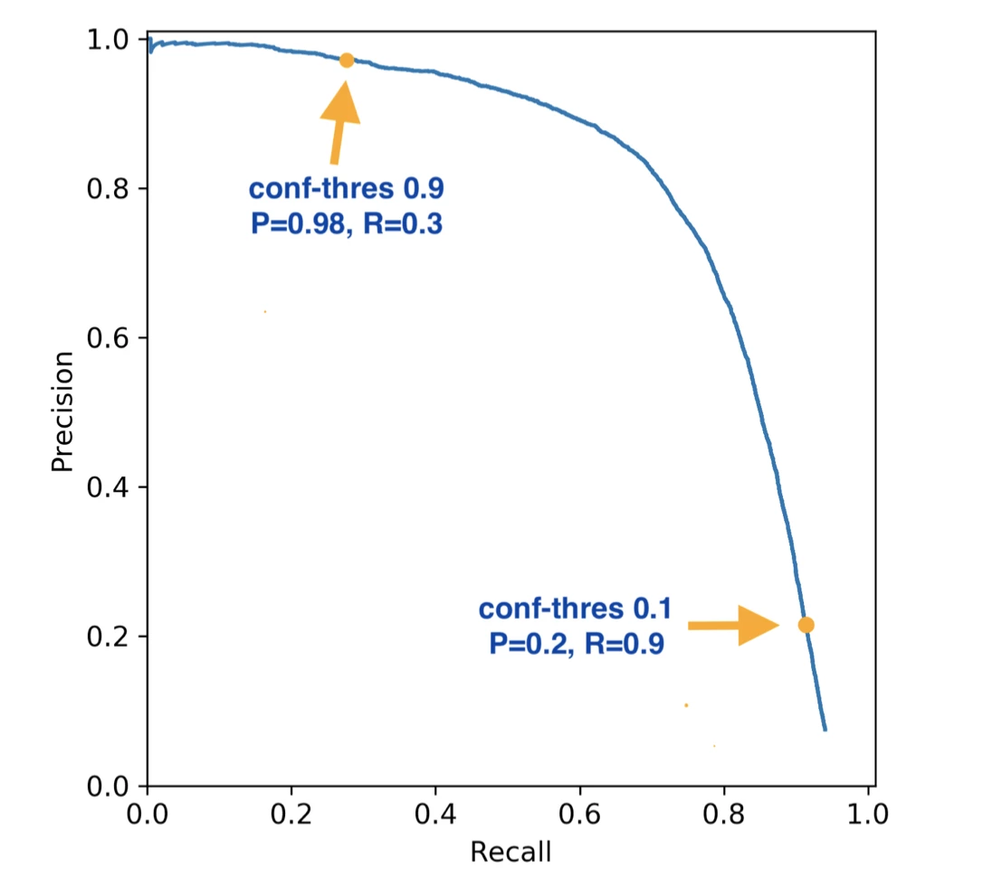
Evaluating IE
If confidences on extraction is provided then sort them and could measure precision at various recall levels
Plot precision-recall curve
Measure area under precision-recall curve (can be used to compare two methods)
Image source: GitHUB

Slide 8
Evaluation: NER (protein names)
Threshold = 0.9
Extracted with confidences:
0.95
0.91
TI - Two potentially oncogenic cyclins, cyclin A and cyclin D1, share common properties of subunit configuration, tyrosine phosphorylation and physical association with the Rb protein
AB - Originally identified as a ‘mitotic cyclin’, cyclin A exhibits properties of growth factor sensitivity, susceptibility to viral subversion and association with a tumor-suppressor protein, properties which are indicative of an S-phase-promoting factor (SPF) as well as a candidate proto-oncogene …
Moreover, cyclin D1 was found to be phosphorylated on tyrosine residues in vivo and, like cyclin A, was readily phosphorylated by pp60c-src in vitro.
In synchronized human osteosarcoma cells, cyclin D1 is induced in early G1 and becomes associated with p9Ckshs1, a Cdk-binding subunit.
Immunoprecipitation experiments with human osteosarcoma cells and Ewing’s sarcoma cells demonstrated that cyclin D1 is associated with both p34cdc2 and p33cdk2, and that cyclin D1 immune complexes exhibit appreciable histone H1 kinase activity …
0.92
0.57
0.91
0.95
0.95
0.89
0.88
0.93
0.92
N=14
E=8 C = 7
Precision = 7/8=87.5% Recall = 7/14 = 50%

Slide 9
Evaluation: NER (protein names)
Threshold = 0.1
Extracted with confidences:
0.95
0.91
TI - Two potentially oncogenic cyclins, cyclin A and cyclin D1, share common properties of subunit configuration, tyrosine phosphorylation and physical association with the Rb protein
AB - Originally identified as a ‘mitotic cyclin’, cyclin A exhibits properties of growth factor sensitivity, susceptibility to viral subversion and association with a tumor-suppressor protein, properties which are indicative of an S-phase-promoting factor (SPF) as well as a candidate proto-oncogene …
Moreover, cyclin D1 was found to be phosphorylated on tyrosine residues in vivo and, like cyclin A, was readily phosphorylated by pp60c-src in vitro.
In synchronized human osteosarcoma cells, cyclin D1 is induced in early G1 and becomes associated with p9Ckshs1, a Cdk-binding subunit.
Immunoprecipitation experiments with human osteosarcoma cells and Ewing’s sarcoma cells demonstrated that cyclin D1 is associated with both p34cdc2 and p33cdk2, and that cyclin D1 immune complexes exhibit appreciable histone H1 kinase activity …
0.92
0.57
0.91
0.95
0.95
0.89
0.88
0.93
0.92
N=14
E=9 C = 11
Precision = 9/11=81.81% Recall = 9/14 = 64.29%

Slide 10
IE Datsets
Several datasets have been created for IE, many through shared-tasks (or competitions)
These are used as benchmarks to evaluate IE systems
Datasets are for general NLP domain as well as for specialized domains, examples:
News stories (e.g. person, location, organization)
CoNLL 2003
Biomedical literature (e.g. proteins)
AIMed
Clinical notes (e.g. diseases, treatments, tests)
i2b2 2010
SemEval 2014

Slide 11
Entity and Relation Extraction
Traditionally, entity and relation extraction is done in a pipeline
First entities are extracted
Then relations are extracted assuming that the extracted entities are correct

Slide 12
Entity and Relation Extraction
However, relations can influence entity extraction
Live_In
Austin lives in Los Angeles, California and works there for an American company called ABC Inc.
Person?
Location?
Person
Location

Slide 13
Entity and Relation Extraction
Relations can also influence extracting other relations
Work_For
OrgBased_In
Live_In
Austin lives in Los Angeles, California and works there for an American company called ABC Inc.
Person
Location
Organization

Slide 14
Joint Entity and Relation Extraction
Both entity and relation extraction can benefit if done jointly
Correct errors of each other
In contrast, in a pipeline, errors of entity extraction can lead to errors in relation extraction
Influence each other
More recently, methods have been developed to jointly extract entities and relations

Slide 15
Bootstrapping for IE
When there are not enough training examples given
Use some “seed” examples, like “Microsoft-Seattle” for Located-In relation
Search a big corpus for a query “Microsoft * Seattle” which would return many hits including for sentences which have “Microsoft in Seattle” etc.
Use this as the training data
Apply the trained system to extract more “seeds” and repeat

Slide 16
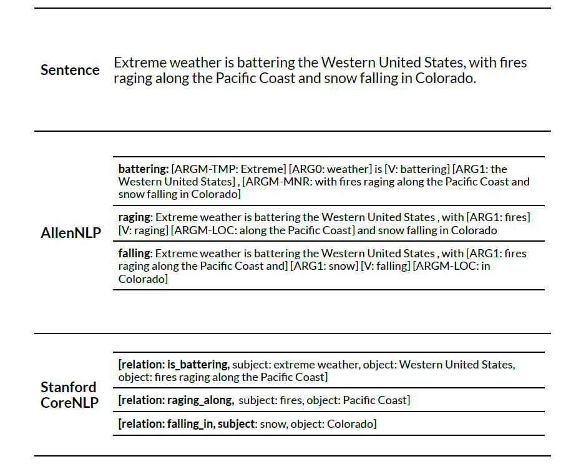
Open Information Extraction
Set of relations to extract are not predefined
Converts text into simple triples of relation and its two arguments
Figure from Textbook 2.

Slide 17
Online Demos
spaCy:
https://demos.explosion.ai/displacy-ent
AllenNLP:
https://demo.allennlp.org/named-entity-recognition/named-entity-recognition
Stanford CoreNLP:
https://corenlp.run/
Commercial systems:
Dandelion https://dandelion.eu/semantic-text/entity-extraction-demo/
Google cloud NLP https://cloud.google.com/natural-language/?hl=en
Microsoft text analytics https://azure.microsoft.com/en-us/services/cognitive-services/text-analytics/
Textrazor https://www.textrazor.com/demo
…

